Slide 1
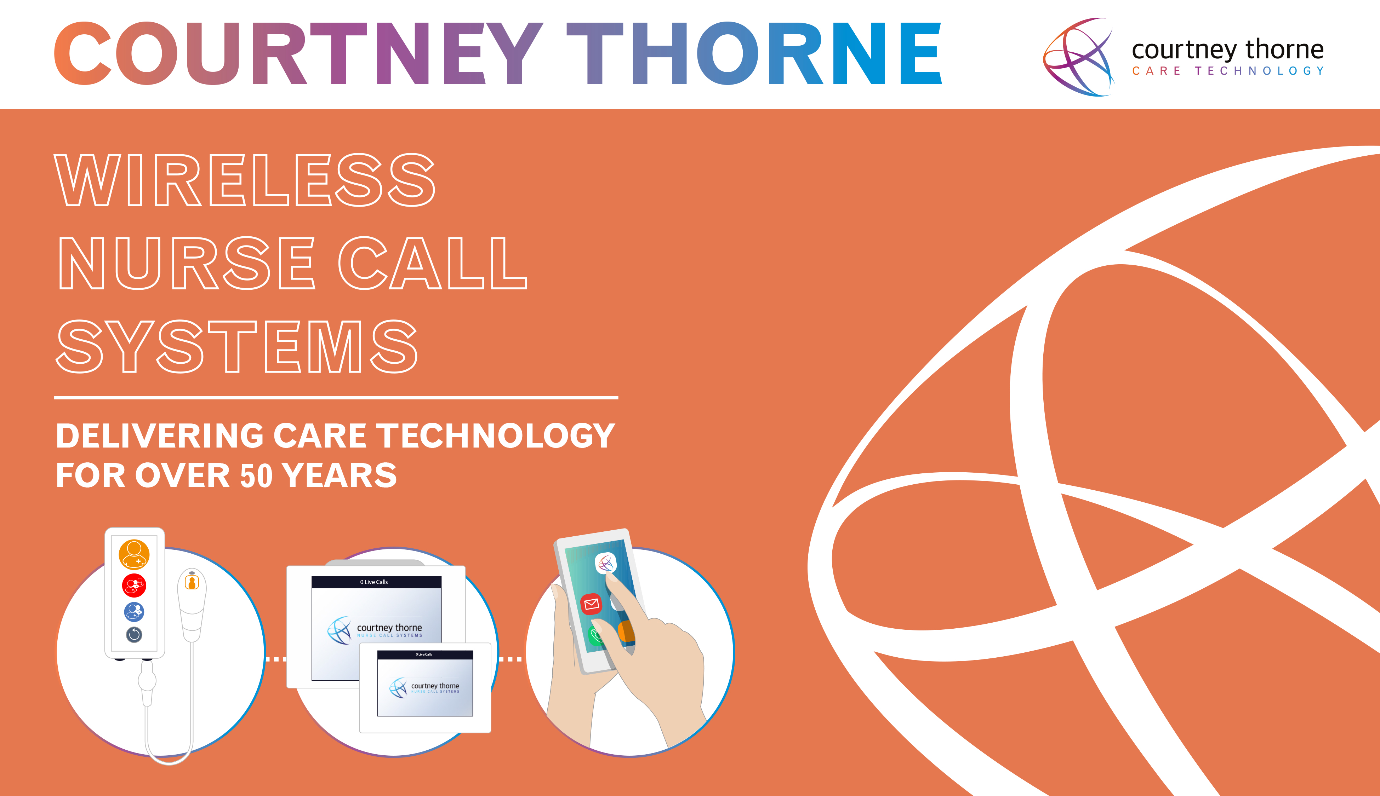

Slide 2

WHO WE ARE…

Slide 3


WE CARE
BECAUSE YOU CARE
With over 50 years’ experience, Courtney Thorne have asserted themselves not just as leaders in the nurse call field – but pioneers. During this time, we have worked with the foremost names in both the healthcare and care home sectors to deliver tailored solutions that enable staff, managers and stakeholders manage their care provision, efficiency and quality.
We are a UK company we design, manufacture, install and maintain solutions for the health and care sectors throughout the UK and in many locations across the world.
Wireless Nurse Call systems incorporating Staff ID (tracking), Local and Cloud Reporting, Smart Phone Apps & Integration and Acoustic Monitoring Technologies clearly demonstrate how Courtney Thorne’s solutions continue to innovate, leading with care technology in the UK and across the world. In doing so we provide complete end to end solutions that not only support health and care providers manage their responsibilities, but also help improve the quality of the lives of patients, residents and those care and nursing staff responsible for them.

Slide 4

CARE
RANGE…

Slide 5

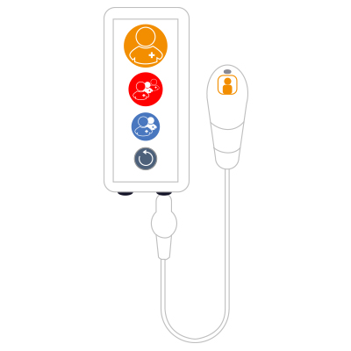
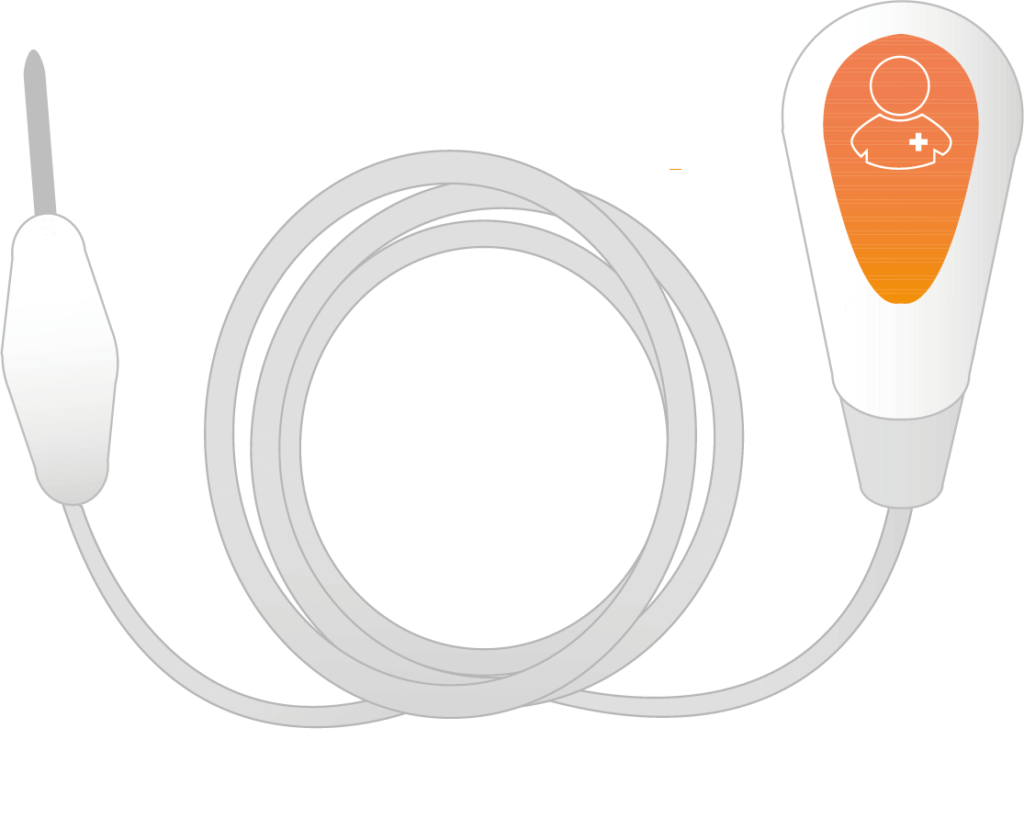
ALTRA & CONNECT CARE RANGE
FULLY COMPLIANT WITH HTM 08-03 GUIDELINES
CALL BUTTON
Patient Call Button
Large button with a nurse symbol and tactile feel (HTM 08-03: 10.49)
Easily recognisable colours
(HTM 08-03: 10.30)
Large and easily recognisable, with a reassurance lamp (HTM 08-03: 10.37)
Illuminated to allow easy location in the dark (HTM 08-03: 10.38)
Staff Emergency Switch
Pull-on / push-off red switch with “Emergency Pull” (HTM 08-03: 10.62)
Labels
Easy to understand symbols for patients (HTM 08-03: 10.8)
Reset Switch
Reset switch to reset an initiated
patient–nurse call (HTM 08-03: 10.58)
PEAR PUSH LEAD
Lightweight, robust Pear Push Lead enabling a call to be activated from the bed or chair
(HTM 08-03: 10.39)
IP67 rated, meaning it can withstand submersion in liquid (HTM 08-03: 10.40)

Slide 6
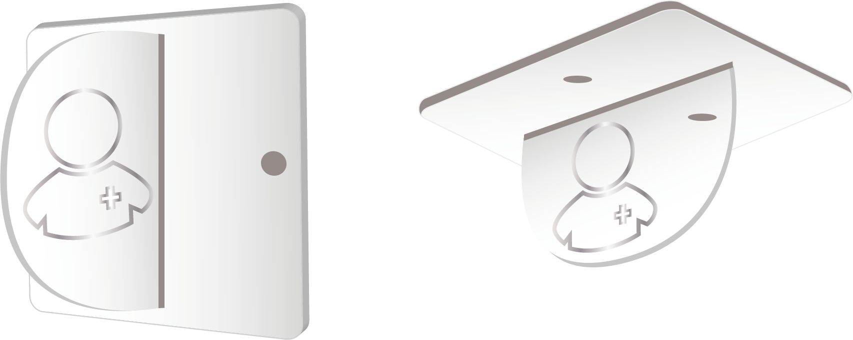

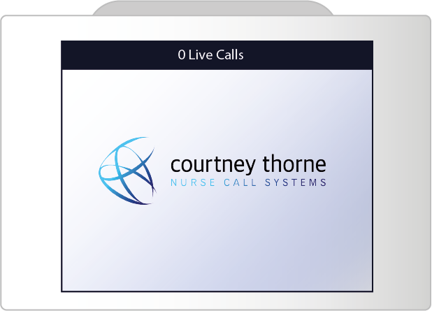
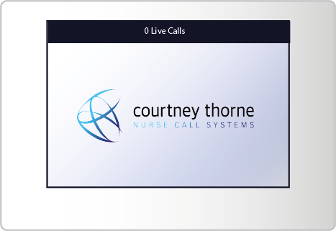




ALTRA & CONNECT CARE RANGE
CEILING PULL CORD
OVER DOOR LIGHT
Over door light above ward / cubicle doors (HTM 08-03: 10.14)
Pull-cord unit for showers, bathrooms and toilets
(HTM 08-03: 10.44)
MAIN DISPLAY PANEL
AND SERVER
MINI DISPLAY PANEL
Cable fault warnings appear on screen (HTM 08-03: 10.53)
Clear audio and visual alerts
(HTM 08-03: 10.69)
Map of the ward locates which room / bed is calling
(HTM 08-03: 10.72)
Logs all calls / events and provides detailed history reports when required (HTM 08-03: 10.3)

Slide 7





ALTRA & CONNECT CARE RANGE
THE RIGHT CHOICE FOR ALL CARE HOMES
CONNECTIVITY
Built in 896.2Mhz Radio and WiFi sensors, allowing connectivity and integration with a wide range of devices.
• Wireless accessories
• Smart device integration
• Independent of Home infrastructure
CAPABILITY
The multiple on-board sensors means your Nurse Call System will allow you to monitor resident and staff activity throughout the home environment, enhancing your ability to provide the safest possible environment for those you care for.
• Staff safety and effectiveness
• Mobile resident monitoring for safety and security
SIMPLICITY
No programming or configuration is required, meaning new Courtney Thorne devices can be added to your system ‘out of the box’.
Our installation process is simple and clean with no wiring required, allowing us to work around an operational ward without disruption to staff and patients.
FLEXIBILITY
The modular nature of the system means it can be added to and reconfigured with ease, providing care homes with a system that can grow and adapt to an ever changing environment.
INFORMATION
Easy to view ‘real time’ reports are accessible at the click of a button, showing how many calls occur, how quickly they are responded to and which nurse responded.

Slide 8

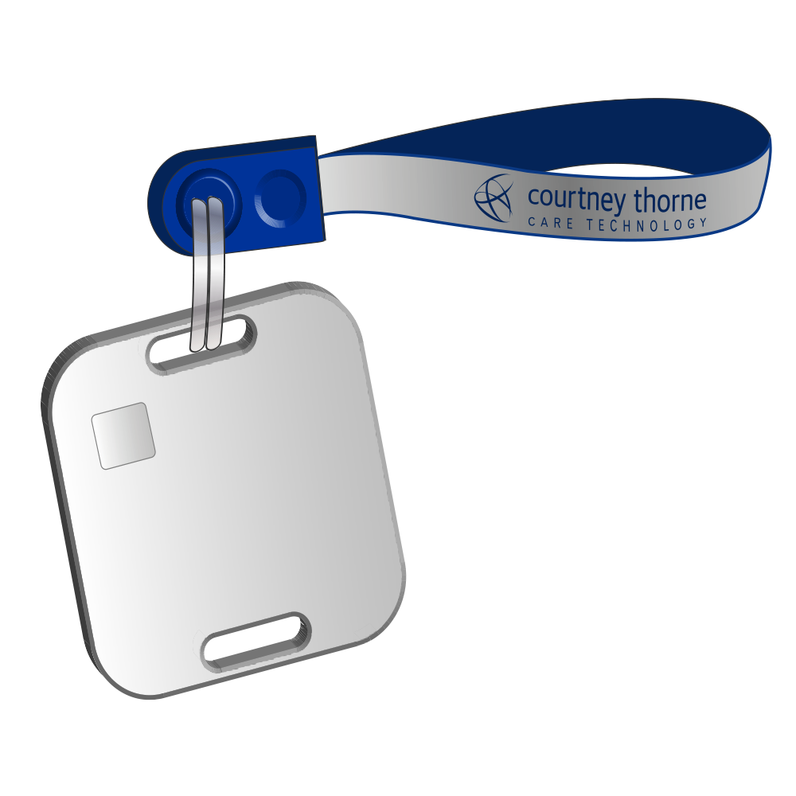
ALTRA & CONNECT CARE RANGE
STAFF TIME & AATTENDANCE AND TRACKING
Monitor who responds , time taken and time spent delivering care. Track and record staff activity, highlight best practices and manage issues. Defend family accusations and provide detailed evidence of care for CQC audits and senior management.
When a call is raised by a resident the carer who responds resets the call button. Automatically the system logs the time and the carer‘s details. When the carer leaves the location the time is also logged. There is no need for any interation by the carer.
Features and Benefits:
Light weight and easy to add to key ring – put in pocket
Automatically “pairs” with the corresponding call unit – no fob to present
No one will forget to present their fob
Less intentional or accidental miss-operation
No user interaction required totally automatic
Location tracking being devloped
Resident location tracking being developed
Staff ID No 25
Bedroom 14

Slide 9

ALTRA & CONNECT CARE RANGE
SMART TECHNOLOGY – CT-CLOUD
INFORMATION
Nurse Call System data includes call times, types, duration, response times, who responded. Across all rooms, beds and wards
Reports are compiled ready to use
Bespoke shift patterns, reporting parameters and frequency
AVAILABILITY
Access up to the minute Nurse Call data reports at any time, from any internet connected device with secure log in
Viewed data is never more than 10 minutes old
System remains fully operational at all times
No need to travel to site to gain important information
SIMPLICITY
Daily email alerts to desk top, lap top and smart device. Data includes ready made graphs and statistical comparisons
Easy to read format with your own data terms and names
No need to go thought complex firewalls totally secure host
Easy to control, export and share reports and data
SECURE
Data is encrypted before being uploaded to Amazon Web Services, the host application. Data is then downloaded via the Courtney Thorne dashboard
AWS is designed as a secure, high-performing, resilient,
and efficient infrastructure
AWS use a Prevent – Detect – Respond – Remediate to optimise security
Reliability is maintained so you are never without critical data

Slide 10
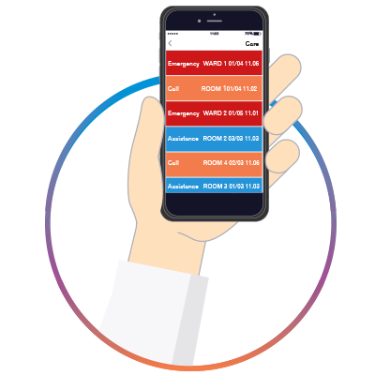
ALTRA & CONNECT CARE RANGE
SMART TECHNOLOGY – ALTRA GO APP
PORTABILITY
The Nurse Call System in a pocket. Alerts sent direct to carers/staff
Speeds up the response times in emergencies
No need to review a fixed display screen to locate an emergency
Remove the need to carry pagers and DECT phones
FLEXIBILITY
App can be added to existing Android devices and integrate with other OEM data applications e.g. Medication and care planning Aps
One device to log data and get reminders and alarms
Single data base to record medication, care and alarms
Save on infrastructure and costly portable devices
CAPABILITY
Uses in-house Wi Fi network and any Android device, simply adds to existing infrastructure and hardware
No need to add additional TX/RX nodes
Use your existing Android Smart device
No need to purchase expensive bespoke mobile solutions
ALTRA GO SMART ANDROID APP
Allows staff to view Nurse Call alarms/calls on the go
Indicates alarms/calls visually, audibly and with vibration
Alarm/call information in the same format as the display screens
No SIM card required – uses in-house Wi-Fi
No bespoke device required – use any Android compatible device
Cost effective based on licencing per smart device used
More cost effective than using pagers
Add as an App to existing Care and E-Med solutions

Slide 11
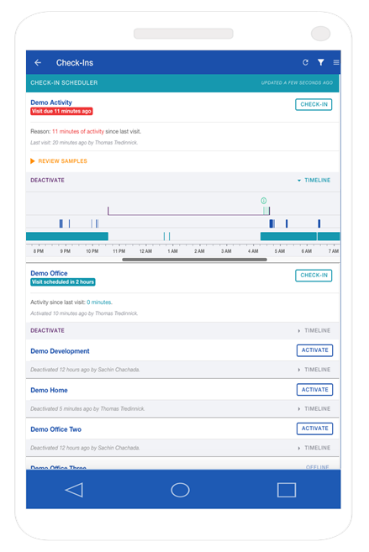

ALTRA & CONNECT CARE RANGE
SMART TECHNOLOGY – ACOUSTIC MONITORING
Intelligently Scheduled night time Check-ins
Acoustic monitor and artificial intelligence tracks a resident’s activity throughout the night
Reduce night check-ins by 75%
Respond only when necessary
Provide better care for high dependency residents
Engage in Other Activities to support the running of the home
Admit higher dependency residents without staffing up.
Reduce agency staff use
SIMPLICITY
One simple audio device per room connected by Wi Fi installed in minutes.
Mobile optimised web-app keeps staff up to date on resident’s well being
Automatically “learns” each resident’s night time acoustic profile
Settings allow acoustic anomalies to be delivered to staff
Recognised improvements in care provision
“{CQC} inspectors reported that {care home’s} acoustic monitoring system enabled staff to respond more promptly and appropriately to people’s support needs during the night”
State of Health Care and Adult Social Care in England 2016/2017

Slide 12
AFTER CARE…

Slide 13


AFTER CARE
Keeping those in your care safe and secure, with total peace of mind is paramount.
Having chosen the UK’s leading Nurse Call solution you’ll want the reassurance that your investment will last for many years
Our award winning service and engineering teams are always available and there are a variety of ways we can support you.
Who better the provide service and support that the same people who designed and built the system
COURTNEY THORNE SERVICE PLANS
Courtney Thorne provide technical support 24/7 - 365 days of the year
Over 90% of customer issues are successfully resolved on the same day of reporting
A system maintained by the manufacturer is the best way to preserve its quality
Courtney Thorne solutions are typically in service for well over 7 years
Some systems are over 15 years old and are maintained by our service team
Our service team are available by phone, remote access and email.
Our fully trained and fully equipped engineers will visit the site if necessary
We have a range of Service Plans to suit all budgets
Costs can be spread across the year with 12 monthly Direct Debit payments

Slide 14
ASSISTIVE TECHNOLOGIES…

Slide 15
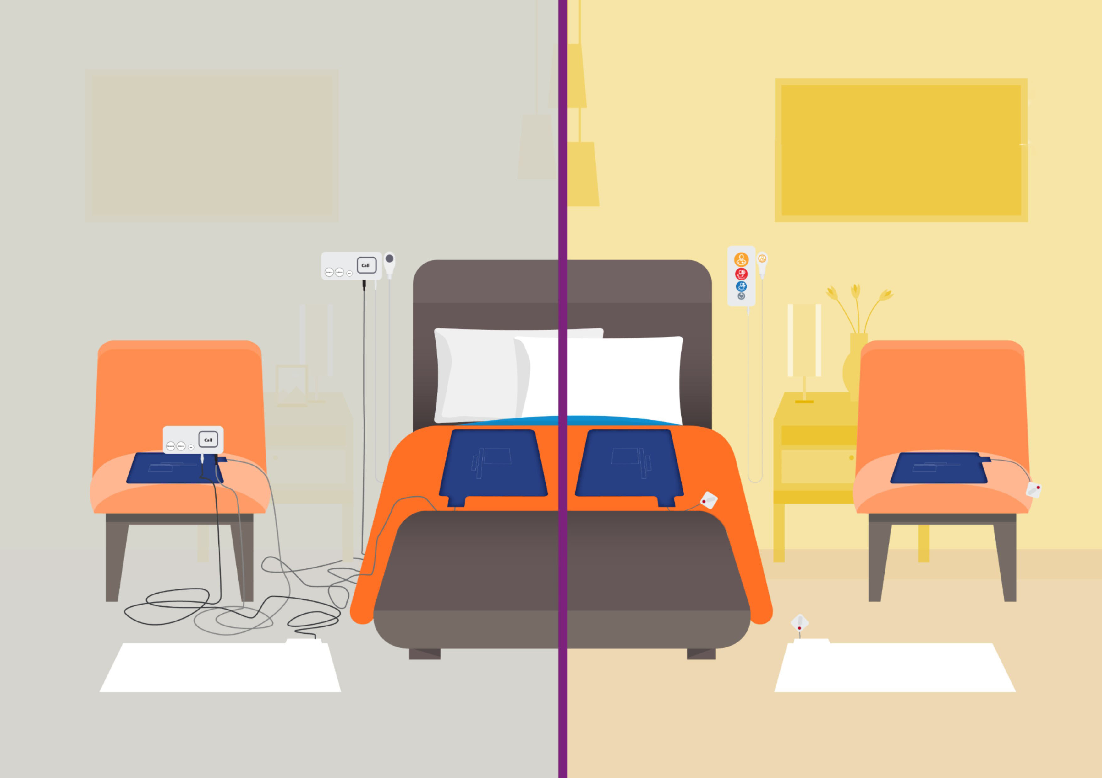
ALTRA LINK
ASSISTIVE TECHNOLOGIES
Altra Link help to prevent trips and falls in all care home and hospital environments by wirelessly connecting commonly used hardwired assistive technology to the Altra Nurse Call System without any hazardous cables or wires.
KEY FEATURES
Nurse call accessories, switches, triggers and many other wired devices can simply and safely connect via Bluetooth, eliminating the need for unsafe trailing cables and wires.
Multiple devices can be connected to one bed or room unit.
10 minute sleep mode for when staff are in attendance.
Can be placed anywhere in a room.
With Altra Link, Courtney Thorne offers the industry’s first true wireless Nurse Call System.

Slide 16
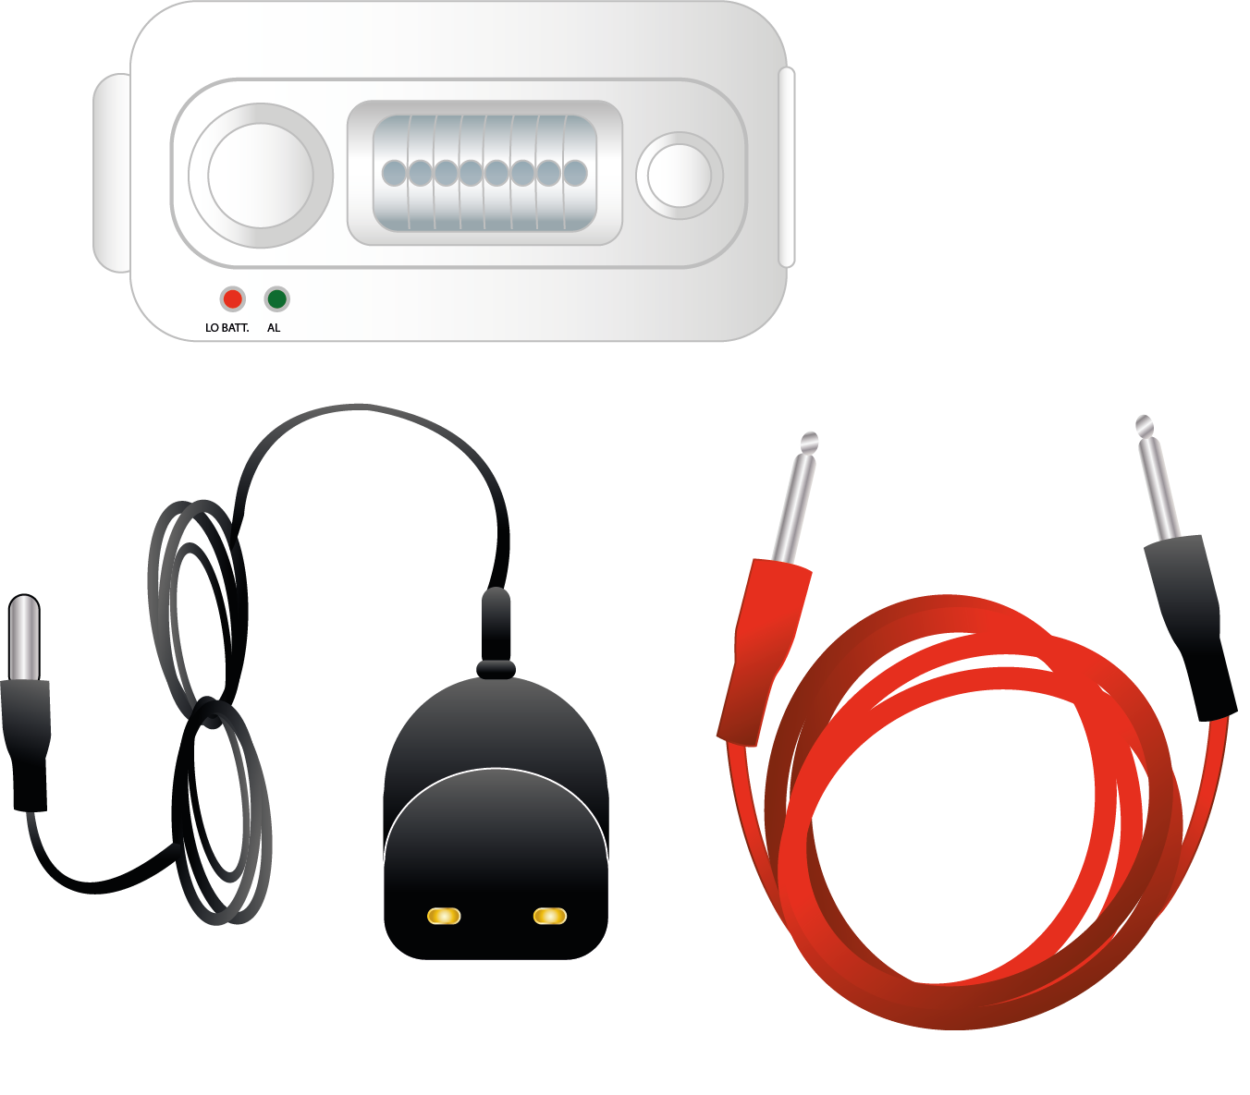

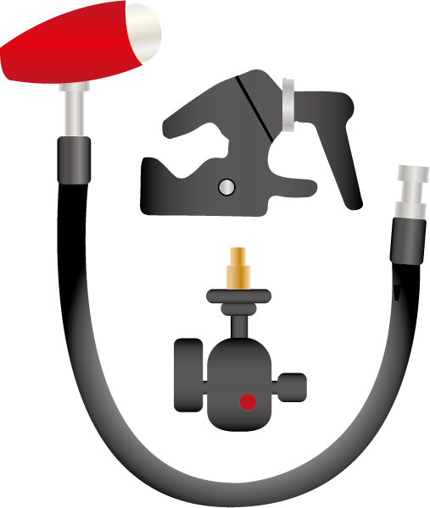
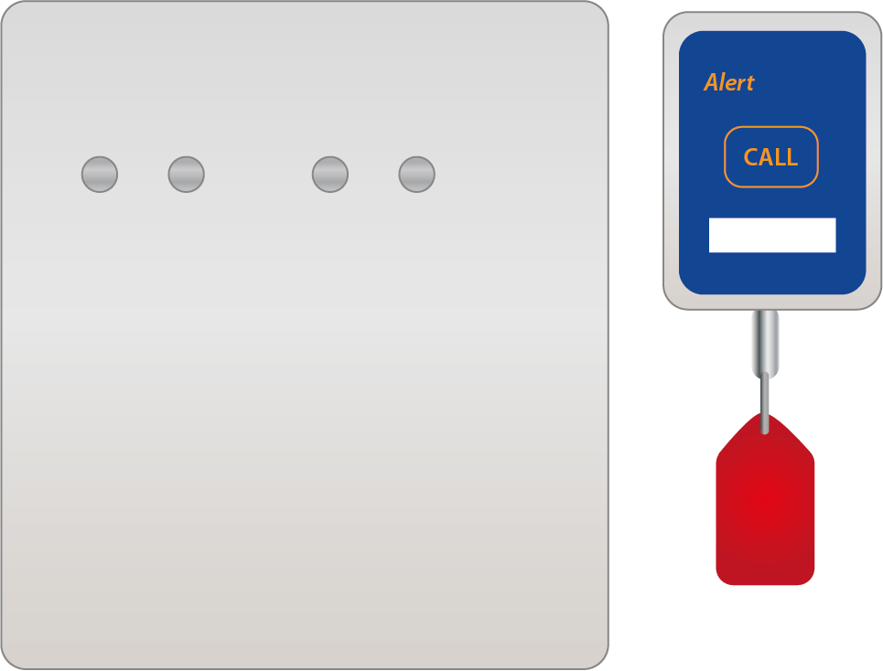
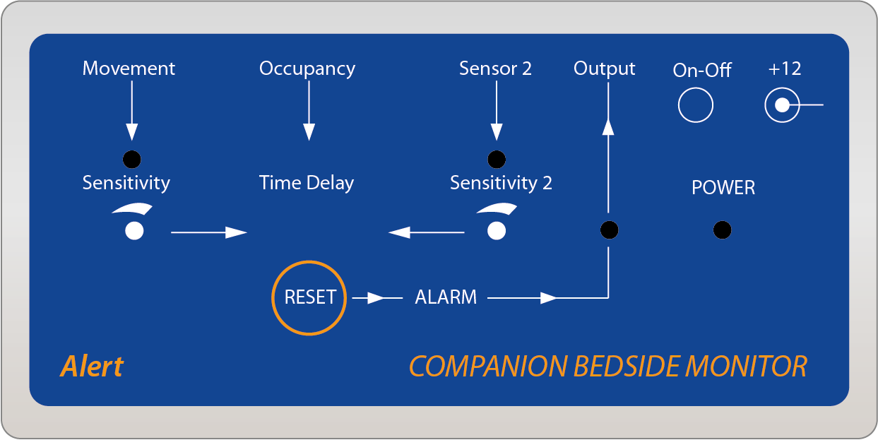
ASSISTIVE TECHNOLOGIES
These are some of the examples of assisted technology that can be used to aid the resident and staff member to trigger a call on this Smart Altra Nurse Call System.
If the resident has limited strength or movement, the Flexi Switch, Ping Pong Switch or Big Red Button would be very useful.
The Bed sensors or the Infrared Trigger is very helpful for residents who have various levels of dementia, notifying staff if the resident is moving around their room, as this would reduce falls.
Other assisted technology the system uses are Enuresis Monitoring, incase of incontinence and Epilepsy Detectors for residents who suffer from seizures.

Slide 17
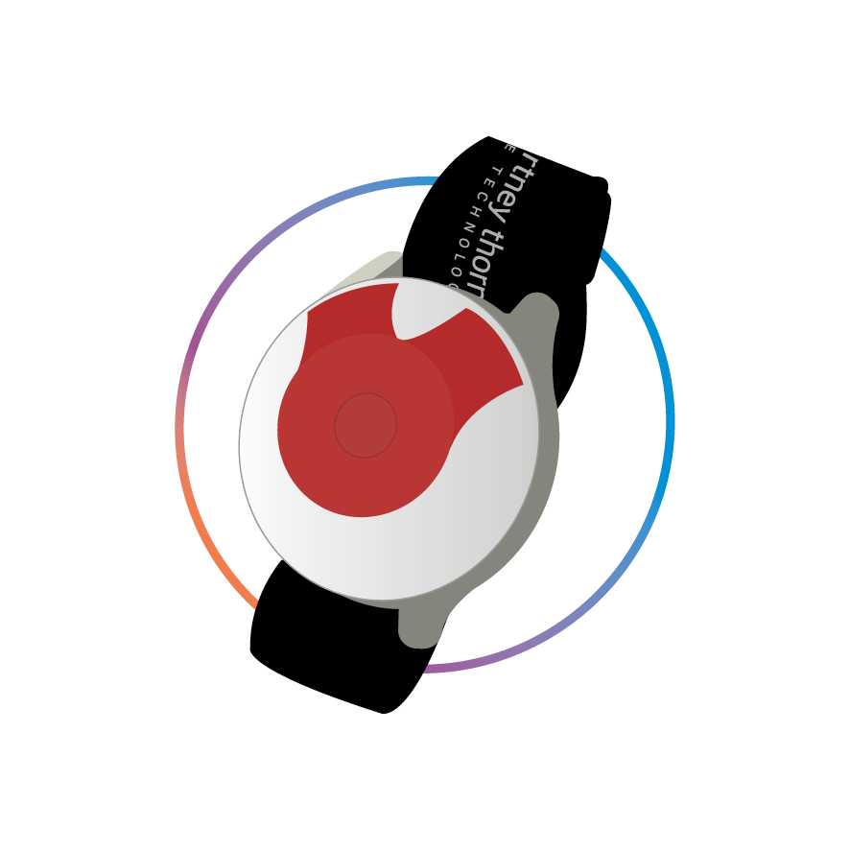
ALTRA WEAR
ASSISTIVE TECHNOLOGIES
For communal and staff area with a compact, low profile design. The multi functional wearable allows the user to make a call, as well as alerting staff if they suffer a fall. Displays Live Call and location information via text or on-screen map. Staff can accept Live Calls via the touchscreen display.
KEY FEATURES
Light weight and comfortable
Elasticated, adjustable wrist strap
Anti-ligature lanyard ensures wearer safety
Waterproof to IP67 specification
Location aware
Fall detection
Temperature sensor
LED feedback

Slide 18
TECHNOLOGY
FOR THOSE
WHO CARE
Courtney Thorne Ltd
Elliot Road
Bournemouth
BH11 8JS
United Kingdom
T: +44(0)1202 573 300
E: info@c-t.co.uk
W: www.c-t.co.uk

